Slide 1
How do we serve gifted and talented students at Treadwell Middle School?
CLUE: Creative Learning in a Unique Environment
The SCS program that serves gifted and talented students through enriched and challenging curriculum is called CLUE. Developed in 1970, the CLUE program has become an international model of how to serve gifted and talented students.
Notes:
Share a brief overview of the program as a whole.

Slide 2
State Identified Gifted Services Qualifications for CLUE
All students in grades 3-8 will participate in the district's universal screener to determine who needs intervention and who needs enrichment in our schools. Students who score within the range of 90th-99th national percentile on either the a Reading or a Math assessment will bring home a letter notifying parents of their participation in the second phase of testing for enrichment, which is provided through our gifted services called CLUE. Students who pass the second phase by achieving within the range of 90th-99th national percentile on both the Comp Efficiency and CB Math CAP assessments in the Illuminate/FastBridge program will be more closely screened to determine next steps towards a comprehensive evaluation for a gifted IEP based on academic need and parental preference. This process includes checklists that both the parent and the child’s teacher must complete. If a comprehensive evaluation is indicated, then the student is referred for IQ and achievement testing conducted by SCS school psychologists. Parents may also choose to have a child privately tested, as long as the test used meets state standards. ​The state criteria requires a CLUE administrator to input data into a Gifted Grid that takes into consideration a combination of factors, including scores from the gifted checklists, IQ scores (minimum 123), achievement scores (multiple scores in the 90th percentile), and creativity. A meeting will be held with the parents to discuss results of testing for every child that completes the assessment process.

Slide 3
How do we serve gifted and talented students at Treadwell Middle School?
*For Fall of 2020
Gifted ELA Instruction
MS/HS students attend CLUE English as their ELA class one hour per day.
Critical and creative thinking taught through novel studies with performance tasks.
Consultation Services
Students at any grade level attending a school with 3 or less CLUE students receive one hour per week.
The one hour of face-to-face instruction with a CLUE teacher is supplemented with online learning.
Gifted IEP Required
Gifted IEP Required
Notes:
These are the three service options for the 2020-21 school year
*Note that the pull-out program does not require an IEP until 4th grade.

Slide 4
CLUE Pull-Out Services
Online Instruction – Hybrid Model
All students will participate in online services that include:
Online services that will include regular synchronous class meetings
Asynchronous independent work, for which teachers will provide targeted feedback and support.
Teachers will take attendance and maintain records of work that is submitted by each student. Student progress will be documented either in the IEP progress report or the local CLUE progress report.
Notes:
All CLUE services will be provided through a hybrid model, meaning that some hours will be served synchronously with teacher guidance in the moment. Some hours will be served asynchronously, meaning that the students work independently and receive teacher guidance digitally. Because CLUE teachers are responsible for communicating student progress with parents, attendance to CLUE classes and progress with CLUE work will be documented. Progress reports will be shared with parents when regular school progress reports and report cards are shared with parents.

Slide 5
Gifted IEP Meetings
Any parent may request an IEP meeting at any time. Parents of CLUE students who do not have an IEP may also request a meeting with teachers at any time.
Until further notice, all parent meetings are to be held virtually. CLUE teachers will support parents with providing an invitation with login information, keeping accurate meeting minutes, and sharing all documentation with parents in a follow-up email.
Notes:
Read aloud or summarize this slide.
*There is NO TESTING allowed at this time. We will communicate to all parents when testing resumes for special education.

Slide 6
How could a parent support their gifted student?
Attend IEP meetings and communicate with school professionals about your child’s needs on a regular basis.
Follow national, state, and local organizations for gifted education.
National Association for Gifted Children - https://www.nagc.org/
TN Association for the Gifted - http://www.tngifted.com/
Shelby County Schools CLUE901 - http://www.clue901.com/
Notes:
Parents, we encourage you to engage with your teachers early and often. If you are able to have some positive communication with those who support your child, it will be easier to approach others when you need help with a school issue.
Think about including an administrator when communicating, as that administrator could become an ally in an IEP meeting. You should always have the CLUE teacher, a general education teacher, and an administrator to join you in any IEP meeting.

Slide 7
CLUE Office Communications
CLUE Updates are shared regularly via social media and other sources:
https://www.facebook.com/clue901/
https://twitter.com/clue901
http://www.clue901.com/
The CLUE Bulletin – Parent Newsletter*
*To be added to our parent newsletter distribution list, please send us your child’s name and school with your email address to: clue@scsk12.org
Notes:
Please consider following us on Twitter or Facebook so that you won’t miss any important announcements about our program. We are planning parent and community engagement events for this school year, and we’d love for you to participate.
If you have not yet received a CLUE Bulletin, please email us at clue@scsk12.org. You must include your child’s name, grade level, and school to be added to the list more quickly. Newsletters were sent out in July and August. Links to these newsletters can also be found on social media and clue901.com.

Slide 8
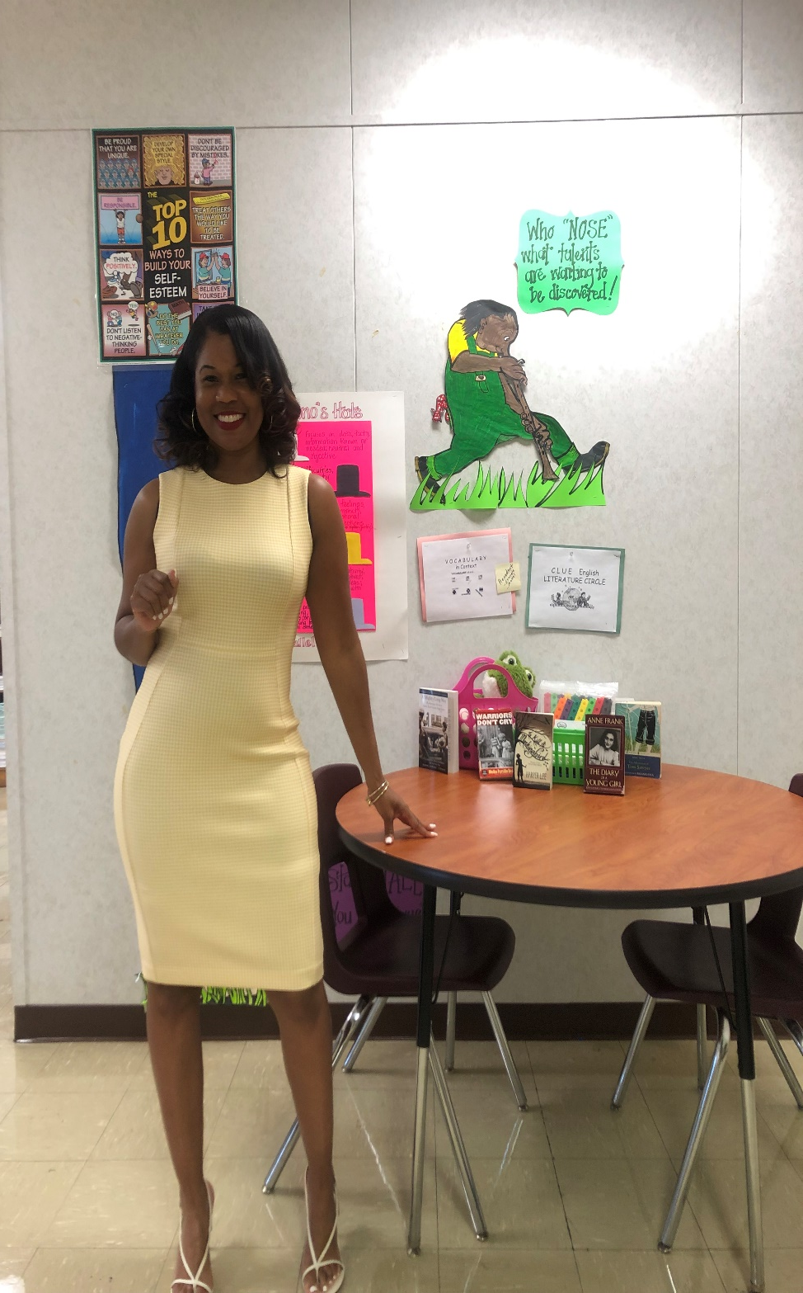
Meet the CLUE Teacher!
Name: Franchesca Tyler Williams, SCS CLUE Teacher
Email: williamsfn@scsk12.org
Google Voice Phone #: 901-401-0181
Schools Served: Treadwell Middle and Kingsbury Middle
I am a product of the Shelby County School System and I attended college right here in my hometown, at LeMoyne-Owen College, an Historical Black College & University. I earned my Bachelor of Science degree and then went on to attend Freed Hardeman University for my Master of Education and Education Specialist degrees. I have been blessed to be a teacher for 20 years now! I love being a teacher and it’s the driving force that motivates me to be my best each day for my students!
Notes:
Personalize this slide. Leave the Twitter and Facebook page for CLUE on this slide. If you want to share your own social media information, add it ABOVE the CLUE program information.

